Slide 1


Algorithmic Trading
TEAM NINE
Presented By
Lakshmi Mutyala, Isha Bhave, Jie Wu, Arely Rosas

Slide 2
Index
Objective | 03
Overview of Trading Strategy | 04
Implementing EMA and RSI | 05
Thought Process Behind the Code | 06
Risk Management Strategy | 07
Performance Analysis | 08
Next Phase of our Project | 09

Slide 3
Objective
Our presentation revolves around using technical analysis and risk management strategies to develop algorithmic trading strategies that aim to maximize returns while minimizing risk. We have researched into the workings of popular technical indicators such as EMA, and RSI to generate buy and sell signals. We have also tried to use risk management strategies such as stop loss levels.

Slide 4


Overview of Trading Strategy
EMA
RSI
RSI stands for Relative Strength Index, which is a technical indicator that helps us identify overbought and oversold conditions in the market. RSI measures the strength of a security's price action relative to its own past performance and provides a reading between 0 and 100. A reading above 70 indicates that the market is overbought and a reading below 30 indicates that the market is oversold.
EMA stands for Exponential Moving Average, which is a technical indicator that helps us identify the trend direction of a security. It does this by placing greater weight on more recent price data, making it more responsive to changes in the market compared to a simple moving average.

Slide 5
Implementing EMA and RSI
We would aim to generate buy signals when the RSI is oversold, indicating that the market is undervalued, and the EMA is sloping upwards, indicating a bullish trend. Conversely, we would aim to generate sell signals when the RSI is overbought, indicating that the market is overvalued, and the EMA is sloping downwards, indicating a bearish trend.

Slide 6
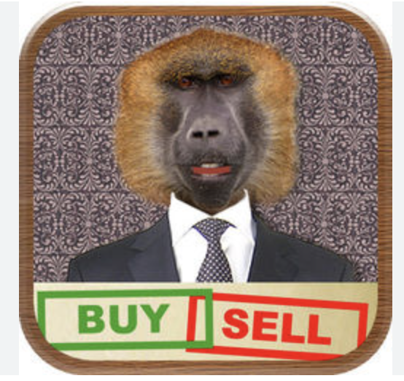
Thought Process Behind the Code
We have 50% probability of choosing the right calls. By using EMA cross or RSI as our indicator, we are trying to increasing the chances of choosing the right call by some percentage and by implementing risk management strategies such as stop loss would decrease our risk further. In our code, we are trying to use multiple indicators to gain conviction on our buy/ sell signals.

Slide 7
In our algorithmic trading strategy, we will be primarily relying on stop-loss orders to manage risk. Stop-loss orders are a key component of risk management in trading, as they allow traders to control the amount of capital at risk for each trade.​
Risk Management Strategy
Support and Resistance levels are generally used to determine the stop loss levels.
The levels can be found out using the price data such as high and low prices.
However, our instruction was to use only the opening and closing prices.
Hence, we have used the percentage-based levels to calculate stop loss, in which, traders can set stop-loss levels a certain percentage away from the entry price based on their risk tolerance.

Slide 8
Performance Analysis of the Resulting Returns
Ticker | Number of trades | Number of profit trades | Number of loss trades | Capital Gains over 20 years period
A | 17 | 12 | 5 | 115%
KO | 34 | 23 | 11 | 71.7%
TMO | 15 | 9 | 6 | 23%
AMZN | 14 | 9 | 5 | 11.76%
YUM | 15 | 11 | 4 | 100.8%

Slide 9
Next Phase of our Project
Adapting trailing stop loss to every trade to improve profits.
We plan to integrate various factors such as market trend, global market conditions, and other relevant indicators into our trading algorithm to enhance its effectiveness.
To improve our accuracy, we intend to analyze the data over multiple timeframes
Try to generate real-time signals by integrating the algorithm with real time data.

Slide 10




Team
Lakshmi Mutyala
ITM
Isha Bhave Finance
Jie Wu
BA
Arely Rosas
Finance

Slide 11

Thank You!
Social Media

